Slide 2
S.16 – Service Provider
Safety Aspects of Battery Electric Vehicles (BEV)

Slide 3
Technology & Maintenance Council
. . . Turning Experience Into Practice

Slide 4
ATTENTION PLEASE
In accordance with TMC Board Policy, all personal phones without a silent feature must be turned off during business sessions.
If you must use your phone —please leave the room!

Slide 5
ATTENTION PLEASE
This is an open meeting of the Technology & Maintenance Council, held in accordance with ATA Antitrust Guidelines which are listed in your meeting packet.
Audio or video recordings are not permitted at this session. However, photography is permissible.
The opinions expressed in this meeting are those of the individual and not necessarily the opinion of his/her company nor of TMC unless stated otherwise.

Slide 6
ANTITRUST/PATENT DISCLOSURE
To minimize the possibility of antitrust problems, the guidelines detailed in your registration packet should be followed at all TMC meetings, task force and study group sessions.
All participants in any group involved in the development of standards or recommended practices shall disclose, as stated in the antitrust/patent disclosure guidelines in your registration packet, all patents or patent applications that are owned, controlled or licensed by the Participant or Participant’s employer when the Participant reasonably believes such patent or patent application may become material to the standard or RP development process.

Slide 7
Constructive Comments Are Always Appreciated!
TMC welcomes your comments, but please make certain that they are constructive and appropriate before you turn in your evaluation sheet!
Thank You for Your Cooperation!

Slide 8
Welcome First Time Attendees!!!

Slide 9
Task Force Leadership
Leadership:
Adam Krey Chairman
David Kegley- Fleet Co-Chair
Joe Christoffel- Co-Chair
Ashley Rush- Co-Chair
Jabali Leonard- Secretary

Slide 10
AGENDA: SAFETY ASPECTS OF BEV
Task Force launched Spring Meeting 2023
Introduction to task force officers
Review of the proposed R.P.
Finalize any changes/additions
Motion for ballot
Adjournment

Slide 11
WHY DO WE NEED THIS RP?
Service Providers and Fleets are being challenged with evolving technology in the transportation industry, and with this evolution, there needs to be a recommending practice for setting up a service bay for Service Providers and Fleets to be able to service their own BEV safely.
This Recommended Practice will be a “Living Document”, meaning as BEV evolve in the industry, updates will happen to this document.

Slide 12
TIMELINE TO RP COMPLETION
Spring 2023 Meeting - Task force kicked-off
Spring 2023 - Fall 2023 - 2 Conference Calls
Fall 2023 Meeting – Draft RP content and sources
Fall 2023 - Spring 2024 - 3 Conference Calls- worked on drafting RP
Spring 2024 Meeting - Review Draft and finalize any changes- Motion to Ballot

Slide 13
Proposed Recommended Practice Draft
Review draft RP

Slide 14
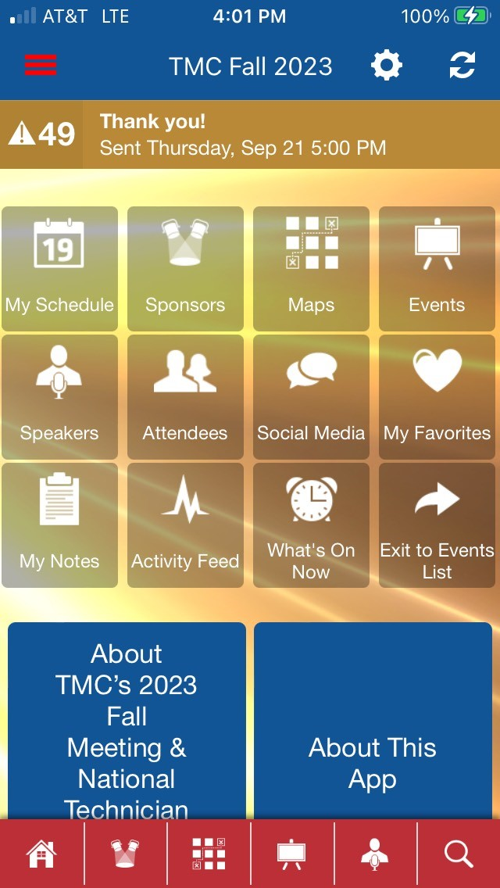
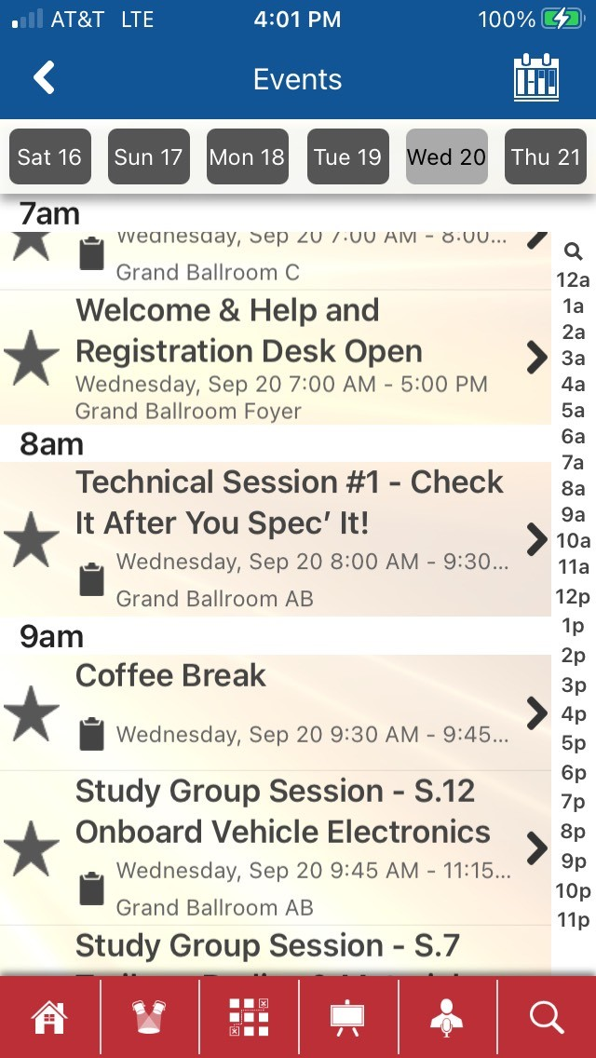
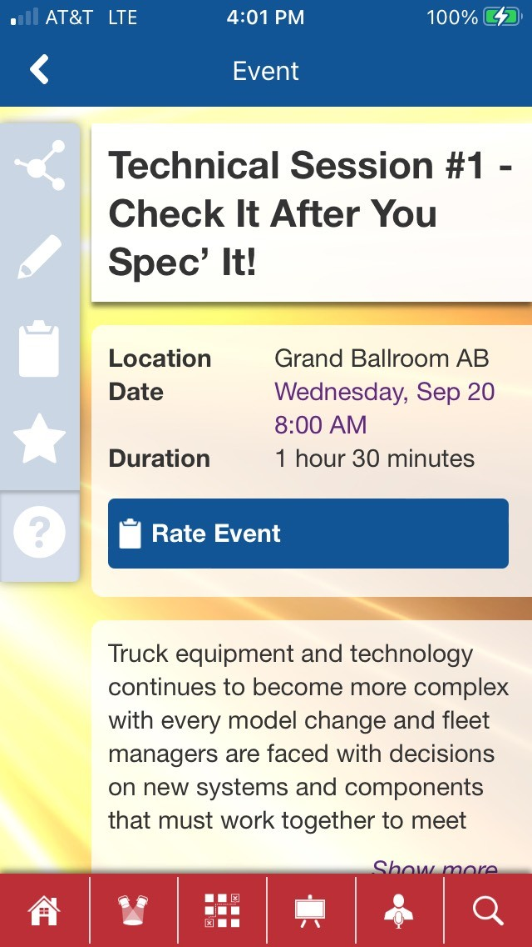
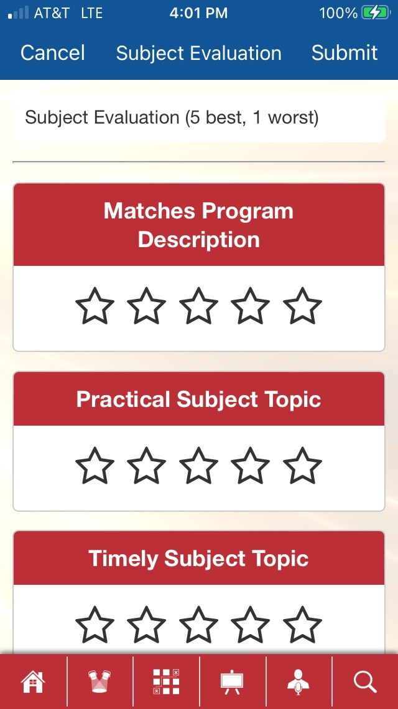
Be Sure to Rate This Session
Please rate technical sessions/mini-technical sessions via the
ATA Events Mobile App. Click the RATE EVENT button from within the session listing under the Events Tab.
Step 1
Step 2
Step 3
Step 4

