Slide 2
S.16 – Service Provider
Safety Aspects of Electric Vehicles

Slide 3
ATTENTION PLEASE
In accordance with TMC Board Policy, all personal phones without a silent feature must be turned off during business sessions.
If you must use your phone —please leave the room!
Session Sponsored By

Slide 4
ATTENTION PLEASE
This is an open meeting of the Technology & Maintenance Council, held in accordance with ATA Antitrust Guidelines which are listed in your meeting packet.
Audio or video recordings are not permitted at this session. However, photography is permissible.
The opinions expressed in this meeting are those of the individual and not necessarily the opinion of his/her company nor of TMC unless stated otherwise.
Session Sponsored By

Slide 5
ANTITRUST/PATENT DISCLOSURE
To minimize the possibility of antitrust problems, the guidelines detailed in your registration packet should be followed at all TMC meetings, task force and study group sessions.
All participants in any group involved in the development of standards or recommended practices shall disclose, as stated in the antitrust/patent disclosure guidelines in your registration packet, all patents or patent applications that are owned, controlled or licensed by the Participant or Participant’s employer when the Participant reasonably believes such patent or patent application may become material to the standard or RP development process.
Session Sponsored By

Slide 6
CONSTRUCTIVE COMMENTS ARE APPRECIATED!
TMC welcomes your comments, but please make certain that they are constructive and appropriate before you turn in your evaluation sheet!
Thank You for Your Cooperation!
Session Sponsored By

Slide 7
AGENDA: SAFETY ASPECTS OF ELECTIC VEHICLES
New Taskforce – 2023
Introductions to task force officers
Scope & Purpose Review
Round Table discussion – pertinent topics to include/consider
Task force participant recruitment
Adjournment
Session Sponsored By

Slide 8
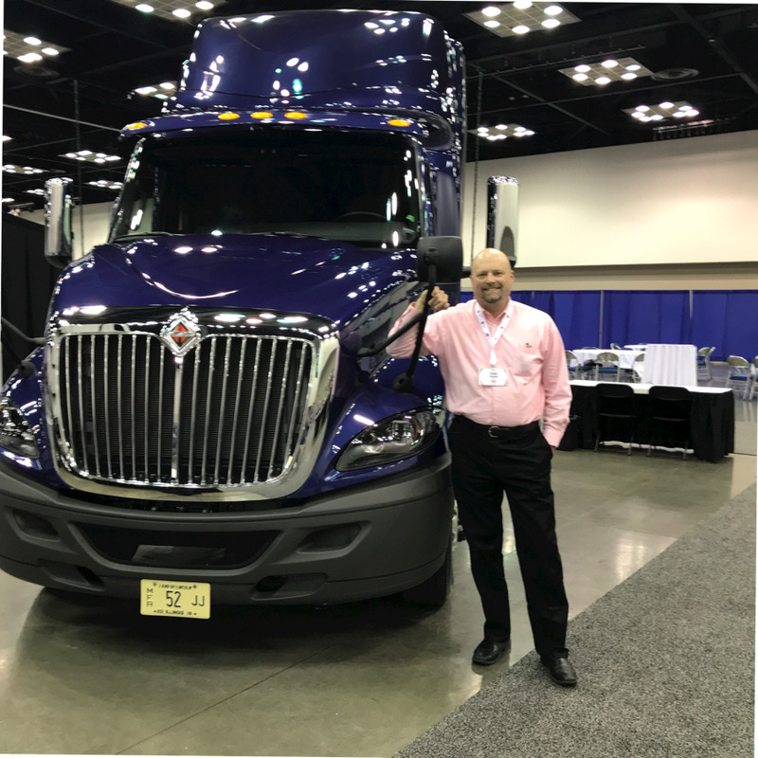
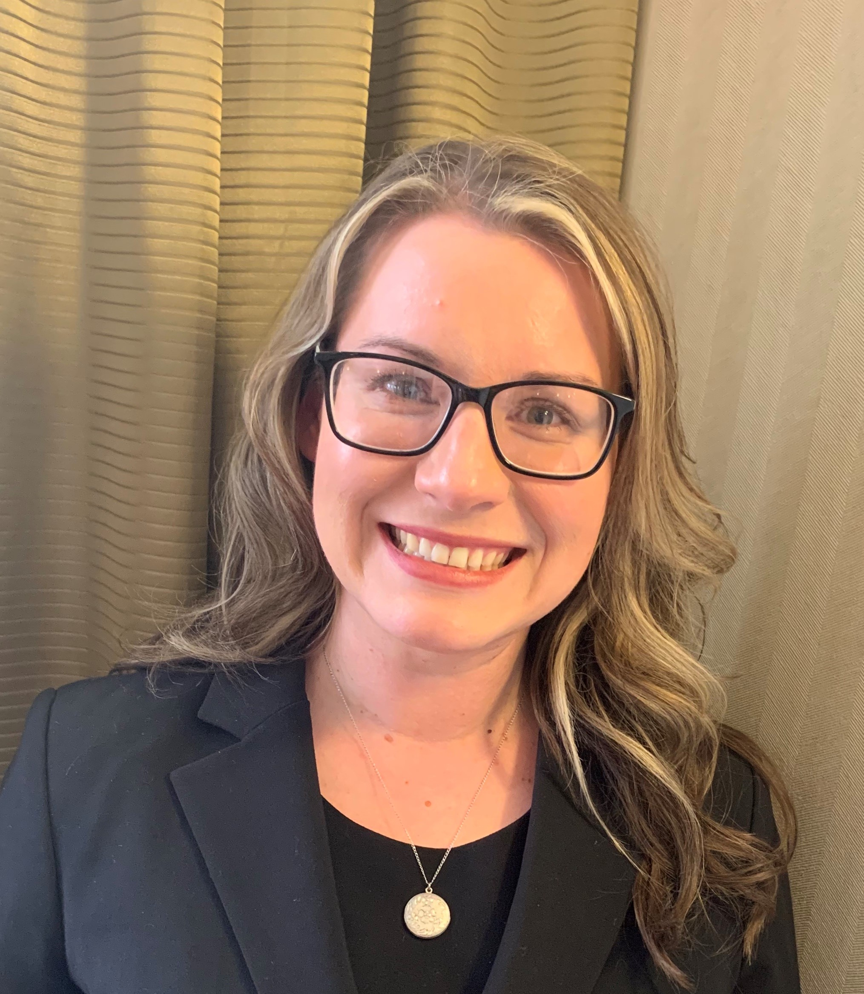
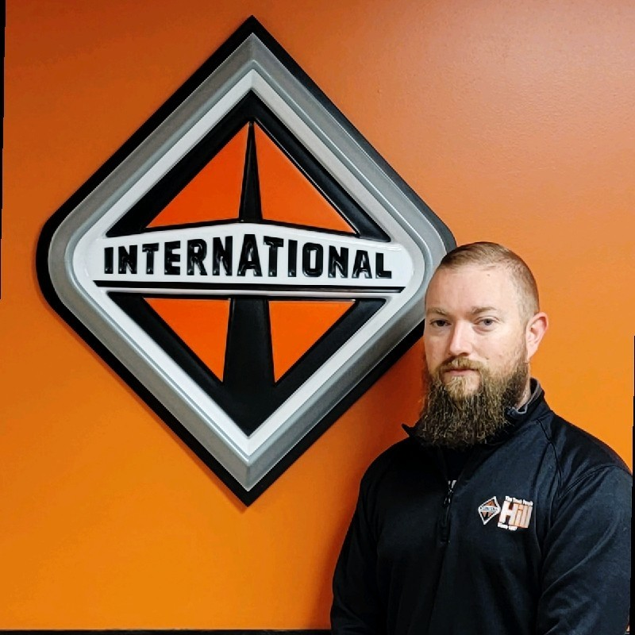
SAFETY ASPECTS OF EV TASK FORCE
Chairman
Chas Voyles
Sr. Director of Regional Sales / SW Region
Navistar, Inc
Chas.Voyles@Navistar.com 260-227-1377
Co-Chair
Ashley Rush
Program Manager – Dealer Uptime Advocate
Navistar, Inc
Ashley.Rush@Navistar.com 440-610-7944
Secretary
Steve Smith
Mobile Manager
Hill International Trucks
SSmith@Hillintltrucks.com 330-383-0431

Slide 9
WHY DO WE NEED THIS RP?
Service Providers are working with extreme high voltage and need to understand the guidelines when working with it.
Session Sponsored By

Slide 10
TIMELINE TO RP COMPLETION
Spring 2023 Meeting - Launch taskforce, work on scope and objective, recruit taskforce members, discuss what we should be looking at, accumulate information through discussion and prepare the information needed to build the R.P.
Between Spring 2023 meeting and Fall 2023 Meeting - we will have two conference calls to work on the R.P.
Fall 2023 Meeting - Work on the information that was gathered, start to structure an R.P.
Between Fall 2023 Meeting and Spring 2024 Meeting - we will have two conference calls to work on the R.P.
Session Sponsored By

Slide 11
TIMELINE TO RP COMPLETION
Spring 2024 Meeting - Review all the information that was gathered, review template and build a rough draft of the R.P. Review R.P. and make any necessary changes. Prepare rough draft of R.P. for ballot
Between Spring 2024 Meeting and Fall 2024 Meeting - we will have two more conference calls to work on the rough draft and prepare it for ballot.
Fall 2024 Meeting - Review the finished draft, make any necessary changes, Send the agreed to draft to ballot after a motion is made
Session Sponsored By

Slide 12
SAFETY ASPECTS OF EV RP TIMELINE
Added Taskforce
Initial Prep
Scope & Purpose
Today
Defining RP
Refine RP
Fall ‘22
Annual ‘23
2 Calls
Fall ‘23
2 Calls
Annual ‘24
Fall ‘24
Session Sponsored By

Slide 13
SCOPE
To bring knowledge to service providers by focusing on all aspects of safety when working on an electric vehicle by identifying all safety concerns that could potentially present itself during a service event.
Session Sponsored By

Slide 14
OBJECTIVE
To create a recommended practice which will define processes, procedures and concerns relating to all aspects of safety during a service event.
Session Sponsored By

Slide 15
WHY IS SAFETY A HUGE CONCERN WITH EV?
Dealing with High Voltage
50 Volts will stop a human heart
New to the industry – Education and Understanding is important
Session Sponsored By

Slide 16
ELEMENTS THE RP SHOULD FOCUS ON
1.
Session Sponsored By

Slide 17
ELEMENTS THE RP SHOULD FOCUS ON
Session Sponsored By

Slide 18
NOTES FROM SPRING 2023 MEETING
Session Sponsored By

Slide 19
NOTES FROM SPRING 2023 MEETING
Session Sponsored By

Slide 20
NOTES FROM SPRING 2023 MEETING
Session Sponsored By

Slide 22
ELEMENTS OF EV SAFETY
Intended Audience – technicians, service writers, parts personnel, etc.
Job #1 – Safety / OSHA
Awareness – Where is the potential hazard?
Proper PPE – Rated gloves, shoes, clothing, shepherds hood and warning signs.
Training – Including Lock Out/Tag Out, HV and Arc Flash
Documents – possess wiring diagrams and service manuals
Proper training program
Emergency procedure – written, posted and trained to
Sustainment procedure – PPE testing procedure & documentation
Session Sponsored By

Slide 23
TEMPLATE
Template content
Session Sponsored By

