Slide 2
TMC’s 2023 Annual Meeting – First-Time Attendee Preparation Webinar
Wednesday, February 8, 2023

Slide 3
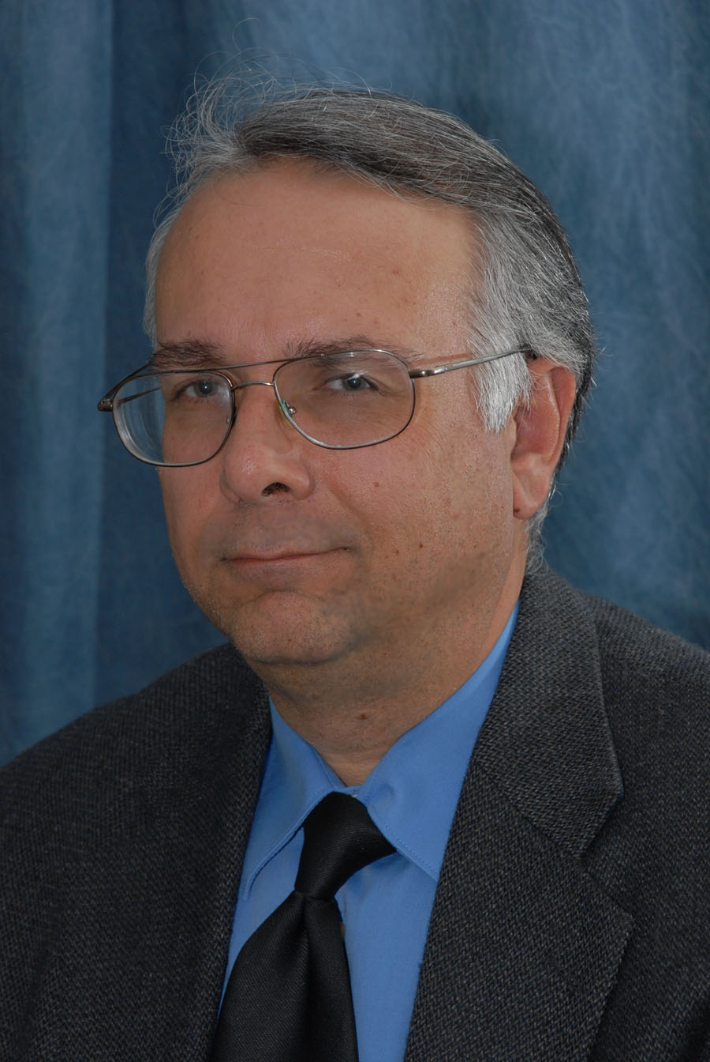
Robert Braswell TMC Executive Director

Slide 4
Welcome in advance to your first TMC event! The American Trucking Associations’ Technology & Maintenance Council (TMC) has existed for more than 60 years and is comprised of a broad cross-section of experienced fleets, equipment suppliers, service providers and educators. No other industry trade association can match the real-world experience and technical expertise of TMC’s membership.
You will be participating in a unique gathering of hundreds of motor carrier professionals who seek to improve heavy duty equipment maintenance.

Slide 5
You will have a front row seat to fleets and industry suppliers developing real-world Recommended Practices to improve your company’s bottom-line and the industry as a whole.
We hope you learn a lot and feel free to ask questions and provide feedback. Get involved and your efforts will pay off in the form of new efficiencies for your operation back home.

Slide 6
TMC’s Value
Practical education on equipment maintenance & fleet operation.
Networking – Access to trucking industry’s best and brightest equipment maintenance professionals… like-minded peers.
TMC Recommended Practices (RPs) – More than 500 individual RPs (under constant development) in the areas of maintenance, engineering, emerging technology and logistics. Trucking industry’s recognized Best Practices.

Slide 7
Go to http://tmcannual.trucking.org
Task Force & Study Group Meeting Schedule
TMC’s Transportation Technology Exhibition Schedule
Mobile App Info
Housing Info
Testimonials
Videos
Other Meetings/Training Opportunities

Slide 8
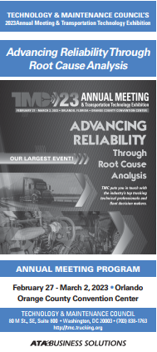
3 Ways to View TMC’s Meeting Schedule
View on our meeting website: http://tmcannual.trucking.org
Download TMC’s Annual Meeting Mobile App
Pick up On-Site Printed Program at TMC’s Registration Desk or at TMC’s Welcome/Help Desk inside the Orange County Convention Center
PDF of onsite program also in 2023 Annual Meeting Presentation Library on TMC Connect

Slide 9
All Full Meeting Registrants & Technicians are Encouraged to Attend TMC’s Transportation Technology Exhibition!
With over 300 vendors from all facets of the industry coming to display their latest and greatest in the trucking industry in an over 500K sq. ft. exhibit hall.
TMC’s Transportation Technology Exhibition Grand Opening and Ribbon Cutting Ceremony will be held on Monday evening, February 27 from 6:45 – 9:15 p.m.!
The exhibit will open Monday evening with three total viewing periods, with a total of 10.5 hours of exhibit time.
The Technician and Educator Committee’s (TEC) Pinewood Derby!

Slide 10
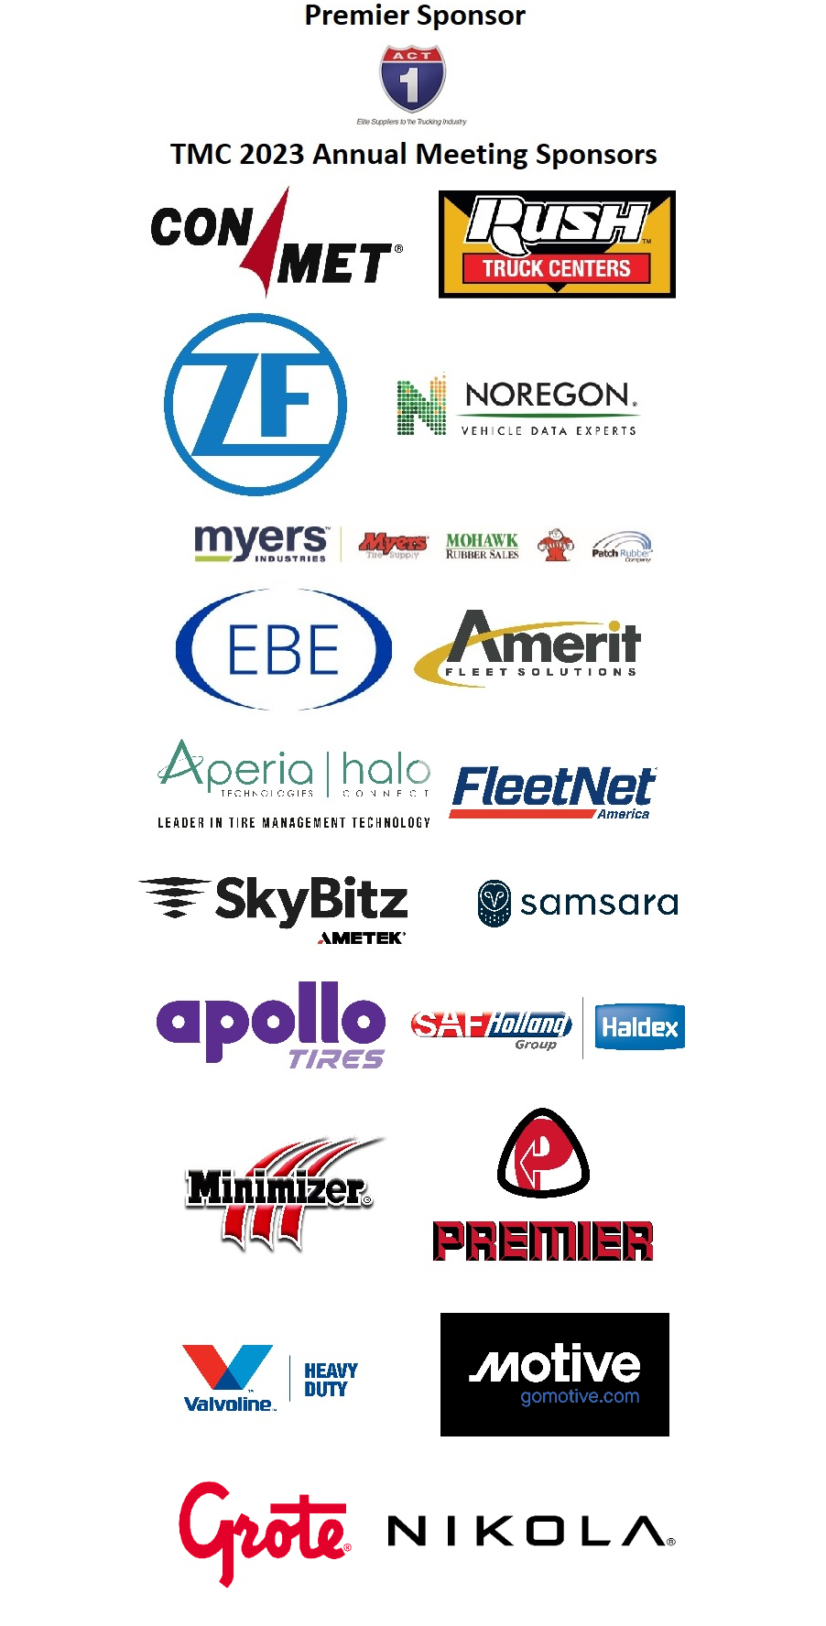
TMC Would Like to Thank Its Sponsors…

Slide 11
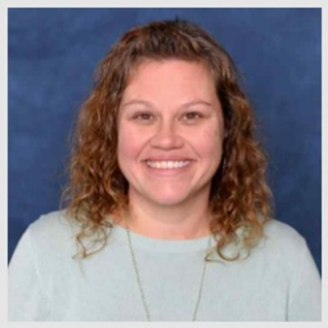
Cori Hicks TMC Administrative Coordinator

Slide 12
Checking In at the Orange County Convention Center

Slide 13
ExpressPass kiosks are located directly in front of the Registration Desk inside the Orange County Convention Center, located on S220 Foyer in the South Hall. (See meeting schedule for hours of operation)
Bring your printed ExpressPass (emailed approx. a week prior to the meeting) or enter your name into the kiosks located near the Registration Desk.
Take your meeting badge to the corresponding Registration Desk (noted by the color on the back of your badge) and receive your meeting packet with drink and social event tickets. Full meeting badges will have a knife and fork to indicate access to food functions.

Slide 14
TMC Welcome/Help Desk Services
First-Time Attendees check-in for a special gift and a red ribbon to denote your first-time status.
Need a TMC Mentor and haven’t requested one yet? Come to the TMC Welcome/Help Desk to get matched up!
Get answers to questions about TMC Membership, TMC Mentors, TMC Leaders of Tomorrow (TLOT) program!
Learn how to navigate your onsite meeting program and/or TMC’s Mobile App.

Slide 15
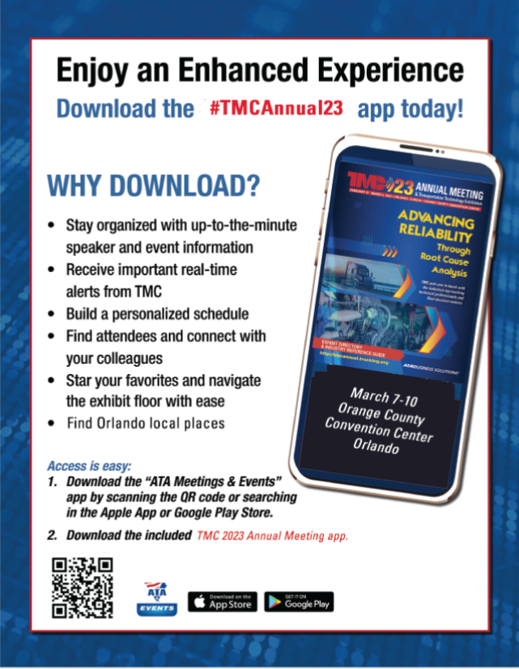
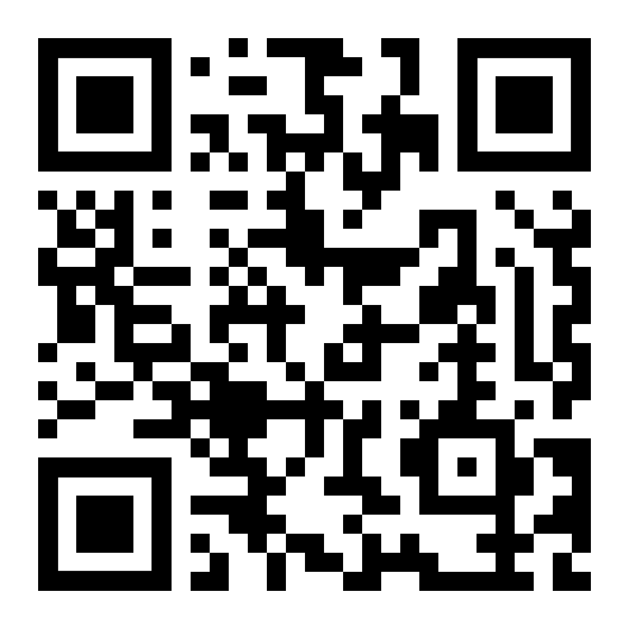
TMC Annual Meeting Mobile App
Available SOON with access to complete on-site program including meeting rooms, speakers and convention center maps.
Join us on Thursday, February 15, 2023 for our Pack Your Bags webinar for all meeting attendees when a Mobile App overview will be presented. Watch your email and TMC Connect to register.
Encourage all meeting attendees to provide feedback through the Mobile App survey or complete the printed on-site program evaluation form.

Slide 16
Complimentary Shuttle Service Provided
Complimentary shuttle service is provided to/from the Orange County Convention Center (OCCC), North Building and the conference hotels. Schedule subject to change: - Saturday, February 25, 2:30pm – 8:30pm - Sunday, February 26, 7am – 6:30pm - Monday, February 27, 6am – 10pm - Tuesday, February 28, 6am – 7pm - Wednesday, March 1, 6am – 6:30pm ** TMC Annual Reception & Banquet – Shuttles to and from Universal Studios, 5pm – 11:00pm - Thursday, March 2, 6am – 12:30pm
*You will receive a shuttle schedule with the routes and times onsite and it will be in the onsite program and in the mobile app. This schedule is set but subject to change*

Slide 17
TMC Mentor Program

Slide 18
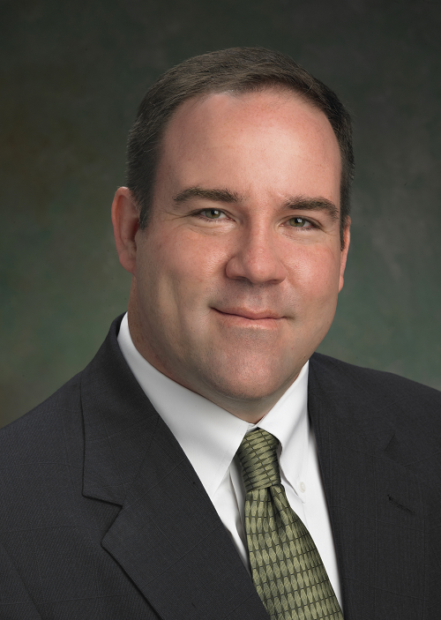
Brant Schneider TMC Mentor Chairman

Slide 19
TMC Mentor Program – First Time For Everything!
What is a TMC Mentor ?
TMC Mentors represent a seasoned committee of Industry Professionals who are knowledgeable and passionate regarding the value that TMC Membership brings to the table. They want to share that value with you !
How can a TMC Mentor help me ?
No matter what area of the industry you represent, a Mentor can help assess your goals and interests as it relates to TMC. From there, your Mentor will dial you in to the various aspects of TMC, so you can extract the maximum ROI from your membership and participation in the council.
TMC Mentors will help you navigate meeting programs, agendas, and select the sessions and seminars that would be of most value to you.

Slide 20
TMC Mentor Program – First Time For Everything! con’t…
How does the program work ?
At your request, a Mentor will be assigned to you. This person will be from your area of the Industry (example: Fleet First-Timers will be mentored by a Fleet Mentor) Your mentor will reach out to you prior to the meeting in order to begin the process.
What if I still need help ?
Your TMC Mentor can be available to you as much or a little as needed ,before, during, and after the sessions. There is “no expiration date” on the knowledge transfer a Mentor will provide as long as you are part of TMC. Many Mentors and “Mentees” continue to collaborate year after year. This often leads to enhanced opportunities and advanced participation in the council as time goes on.

Slide 21
TMC’s First-Time Attendee Orientations Choose which orientation works for you!
Monday, February 27– 7-7:30 am
Monday, February 27 – Noon-1 pm (Buffet Lunch Included)
Please make sure to have your badge with your red ribbon and check-in with the staff at the door.
If you chose to have a mentor, meet them here face-to-face!
Enjoy a buffet lunch at the afternoon orientation as you network with TMC leadership and other first-time attendees!
Meet TMC’s leadership and hear/see an overview of TMC’s meeting and membership benefits.
Ask questions and/or provide feedback.

Slide 22
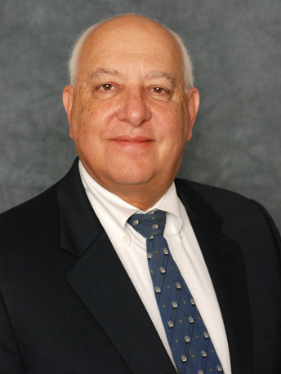
Jack Legler TMC Technical Director

Slide 23
How TMC Enhances Trucking Operations – With Your Help!

Slide 24
Task Force vs. Study Group
What’s the Difference?
Study Groups are ongoing committees that identify industry challenges with respect to equipment and maintenance. If a Study Group decides a particular problem merits attention, it votes to create a Task Force to solve it. TMC has 15 active Study Groups overseeing nearly 100 Task Forces.
Task Forces are short-term subcommittees of Study Groups that solve problems, usually through the development of a TMC Recommended Practices. Sometimes, a Task Force may decide the best solution is a technical session, mini-technical session or an information report.

Slide 25
How can I get Involved ? – Fleet (Yellow Badge) Example
Support Meetings
Fleet Talk
Support RP’s
Task Force Chairman
Study Group Leadership (Chairman/Vice Chairman)
Support Council Development
Mentor Committee
TLOT
Fleet Operator’s Forum
Review an RP with comments
Membership Outreach

Slide 26
How can I get Involved ? – Associate ( Blue Badge) Example
Support Meetings
Sergeant at Arms
Meeting Mechanic
Support RP’s
Task Force Secretary
Study Group Secretary
Support Council Development
Mentor Committee
Membership Outreach
Sign Committee
TLOT
Task Force Chairman

Slide 27
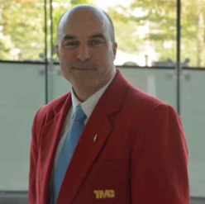
Who is TMC Leadership? What Do the Jackets Mean? Con’t…
The TMC Board of Directors will have on the red jackets. This will be our General Chairman, Vice-Chairman, etc.
Example: Randy Obermeyer, TMC General Chairman & Treasurer

Slide 28
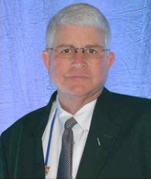
Who is TMC Leadership? What Do the Jackets Mean? Con’t…
The individuals you will see around the meeting wearing a green jacket are Associate Vice Chairman. There are many different associate vice chairs which make up the Associate’s Advisory Group.
Example: Roger Maye, Chairman of Associates

Slide 29
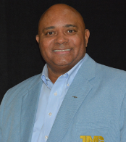
Who is TMC Leadership? What Do the Jackets Mean?
Each TMC Study Group is headed by a Chairman. These individuals you will see around the meeting wearing a blue jacket.
Example: S.16 Service Provider Study Group, Study Group Chairman is Homer Hogg

Slide 31
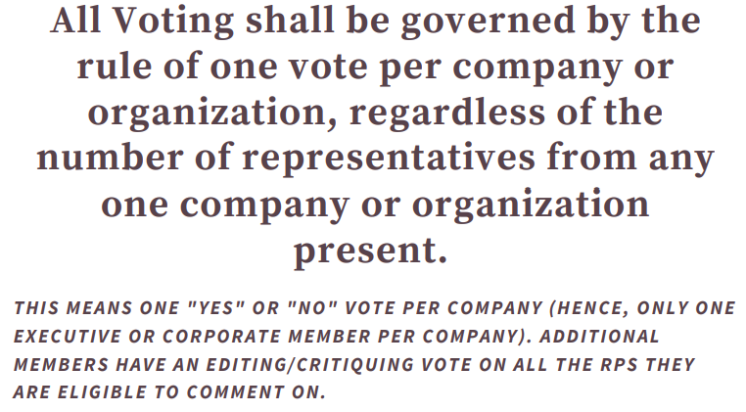

Slide 32
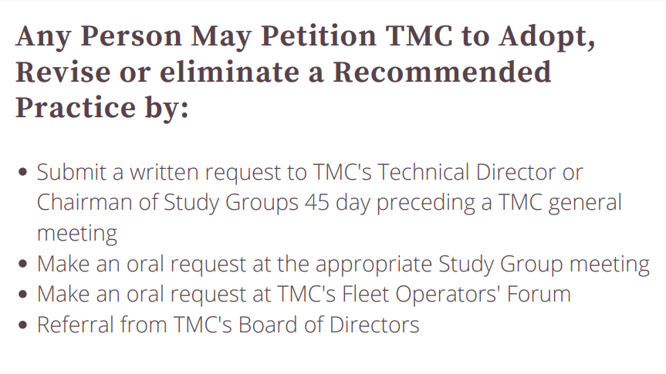

Slide 36
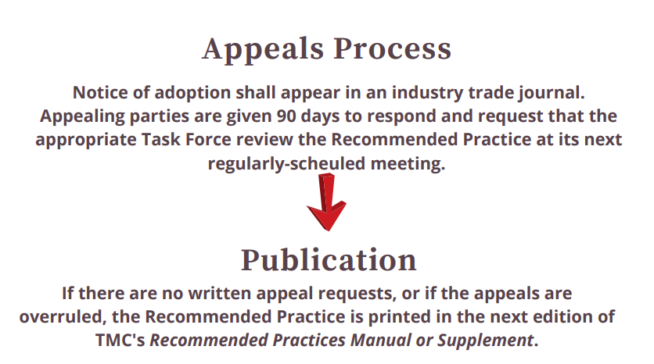

Slide 37
TMC 2023 Annual Meeting Technical Sessions & Other Highlights
All Content Chosen & Developed by TMC Members; Open to all Full Meeting Attendees
More than 100 Task Force Meetings (Monday, February 27)*
Monday’s Town Meeting & Fleet Operators’ Forum
TMC’s Transportation Technology Exhibition (Grand Opening February 27!)
Tuesday’s Kickoff Breakfast
Special Ride & Drive event!

Slide 38
TMC 2023 Annual Meeting Technical Sessions & Other Highlights
All Content Chosen & Developed by TMC Members; Open to all Full Meeting Attendees Continued…
Wednesday’s Awards Luncheon
Four Full Technical Sessions*
Multiple Mini-Technical Sessions
Universal Studios Social Event Wednesday Night!
* See onsite program or mobile app for session topics.

Slide 39
Questions? We can answer your questions now!
(Use Q&A area in bottom right corner of webinar screen)
You can also email TMC at tmc@trucking.org or call 703-838-1763
See everyone in Orlando!

Slide 40
Constructive Comments Are Always Appreciated!
TMC welcomes your comments, but please make certain that they are constructive and appropriate when rating this session!
Thank You for Your Cooperation!

