Slide 2
Technology & Maintenance Council
. . . Turning Experience Into Practice

Slide 3
VMRS Coding for Predictive and Prognostic Maintenance
Brian Mulshine, Navistar Secretary: Robert Nordstrom, Decisiv Inc.

Slide 4
ATTENTION PLEASE
In accordance with TMC Board Policy, all personal phones without a silent feature must be turned off during business sessions.
If you must use your phone —please leave the room!

Slide 5
ATTENTION PLEASE
This is an open meeting of the Technology & Maintenance Council, held in accordance with ATA Antitrust Guidelines which are listed in your meeting packet.
Audio or video recordings are not permitted at this session. However, photography is permissible.
The opinions expressed in this meeting are those of the individual and not necessarily the opinion of his/her company nor of TMC unless stated otherwise.

Slide 6
ANTITRUST/PATENT DISCLOSURE
To minimize the possibility of antitrust problems, the guidelines detailed in your registration packet should be followed at all TMC meetings, task force and study group sessions.
All participants in any group involved in the development of standards or recommended practices shall disclose, as stated in the antitrust/patent disclosure guidelines in your registration packet, all patents or patent applications that are owned, controlled or licensed by the Participant or Participant’s employer when the Participant reasonably believes such patent or patent application may become material to the standard or RP development process.

Slide 7
Task Force Agenda
Call to Order / Opening Remarks / ATA Antitrust Guidelines
Old Business
Discuss updates that have been collaborated on to support the new VMRS code request
Other / New Business
Request to move to Ballot
Adjournment

Slide 8
Constructive Comments Are Always Appreciated!
TMC welcomes your comments, but please make certain that they are constructive and appropriate before you turn in your evaluation sheet!
Thank You for Your Cooperation!

Slide 9
Background
This Task Force was stimulated 2022 Fall meeting
Officially kicked off this Task Force at the 2023 Spring meeting in Orlando, Florida
Three additional open Web Based meetings (Great Participation)
Multiple manufacturers, technology providers and customers also worked closely together, shared thoughts and compromised during additional sessions to ensure the new potential VMRS code key could be adopted by all.
Task Force name is VMRS Coding for Predictive and Prognostic Maintenance, it was recommended to call the new code key “Maintenance Labor Alerts”

Slide 10
New Terminology: Remaining Useful Life
Remaining Useful Life aka: RUL
Multiple vehicle and engine manufacturers have data currently or becoming available soon:
Oil Condition / Life
Oil Filter
Fuel Filter
Air Filter
DEF Filter
DPF Filter
Transmission Oil & Filter
Tire Condition
Technology can improve TCO by providing “Insights” for accurate Dynamic Data Driven Intervals!

Slide 11
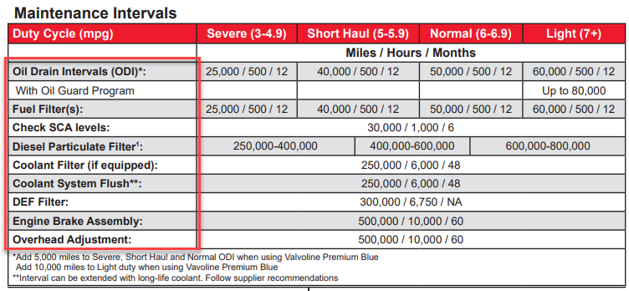
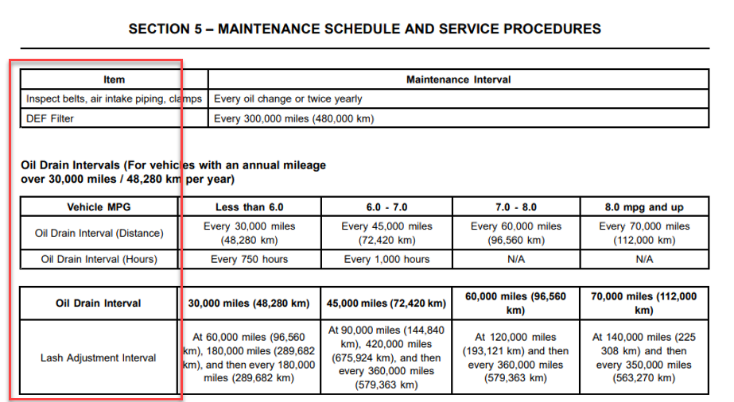
Potential New Maintenance Code Key:
S.5 has a Task Force working on a potential new code key for Maintenance Labor Alerts to be used as a common language to indicate when maintenance labor is required!

Slide 12
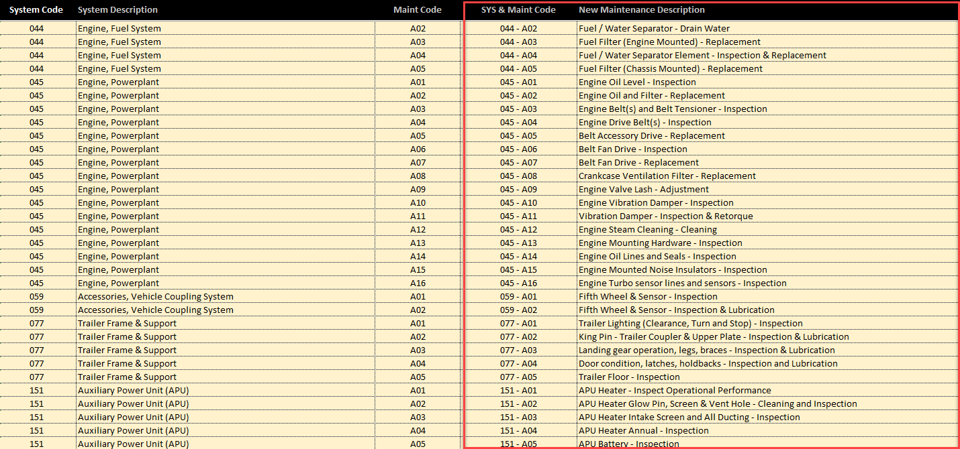
Discussion – Potential Path:
“Proposed” New Maintenance Labor Alerts Codes: Starting with Letters to protect prior art:
We will start with the letter “A” and leverage sequential characters when required!

Slide 13
Status Codes:
Status / Disposition:
Code Key 16 identifies the “Repair Priority Class” for in many cases is indicating when a labor function needs attention. Our recommendation is to leverage CK 16 for Maintenance Labor Alerts!

Slide 14
Requirements / Needs:
OEM Data
Telematics Data
Truck / Manufacturer / Dealers
FMS / Customer
Service Requirements – Due Soon, Past Due, Replace Soon
Past Due
Oil Change, Fuel Filter, Lube Driveline
Due Soon
Valve Lash Adjustment, DEF Filter
Service Event – AT Dealer (Service Provider) “Pull Request”
Service Requirements – Due Soon or Past Due
Past Due
Lift gate, Oil Change, Fuel Filter, Lube Driveline
Performed
Air Dryer, Valve Lash Adjustment, DEF Filter

Slide 15
Requirements / Needs:
Truck / Manufacturer / Dealers
FMS / Customer
Need to Update Systems – Both Sides
Dealer Maintenance Performed ( Provider, RO #, Items, Date, Odometer / Engine Hours)
Service Requirements – Performed (Items, Date, Odometer / Engine Hours)

Slide 16
What is the Desired Outcome:
Data Generators
Vehicle Manufacturers
Engine Manufacturers
Transmission Manufacturers
Fleet Management Systems
Service Providers
Vehicles / Trailers
Telematics Providers
Customer / Fleet
Fleet Mgmt. Systems

Slide 17
Example: Maintenance Alerting
Below are the data element structure for creating a VMRS full description request:
System Group - 31
Maintenance Alert Codes - XX
Code Key 16
Code Key 31 – Available
No Change Required!
Proposed New Code
Code Key 16 – Available
Add New Statuses Needed!
Predictive Maintenance Example:
“044” : Engine Fuel System
“A03” : Fuel Filter Replacement
“04” : Due Soon
“043” : Engine, Exhaust System
“A04” : DPF Cleaning
“05” : Past Due
After Service is Performed:
“044” : Engine Fuel System
“A03” : Fuel Filter Replacement
“06” : Performed
“043” : Engine, Exhaust System
“A04” : DPF Cleaning
“06” : Performed

Slide 18
API Potential Payload:
API Payload
Duration to Past Due
Mi. or Km.
Engine Hours
Days
Parts Required VMRS Codes
API Payload:
044-A03-004 (Fuel Filter Replacement – Due Soon)
Due At Miles: 152,001
Due At Kilometers: 244,621
Engine Hours:
Days:
Special Message:
Required Parts: 044-002-002, Qty. 1, Each (Gallons, Quarts, Liters, Pint – etc.)
(Element - Fuel Filter, Primary)
API language will be determined by technology providers – Not in this RP!

Slide 19
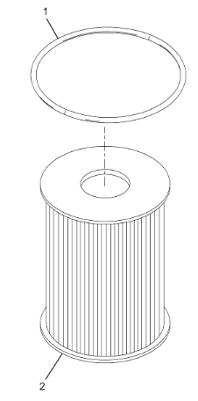
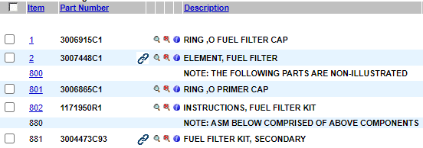
API Potential Payload:
Parts API End Point:
VIN + 044-002-002 to Get Part Numbers & Descriptions!

Slide 20
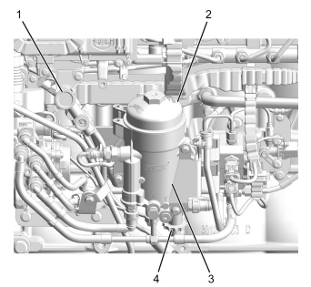
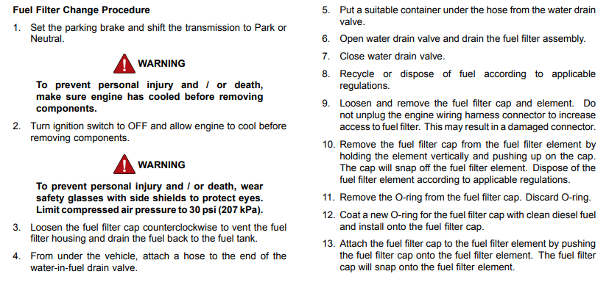
API Potential Payload:
Deep Link to Manual:
VIN + 044-A03-004 (Fuel Filter Replacement – Due Soon)

Slide 21
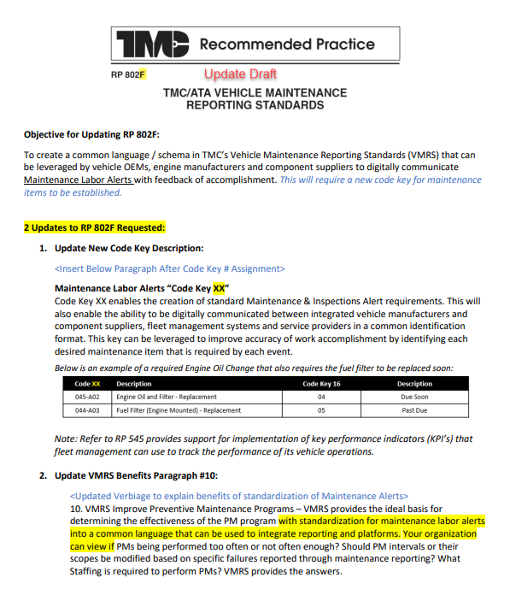
Update for RP 802F Maintenance Labor Alerts

Slide 22
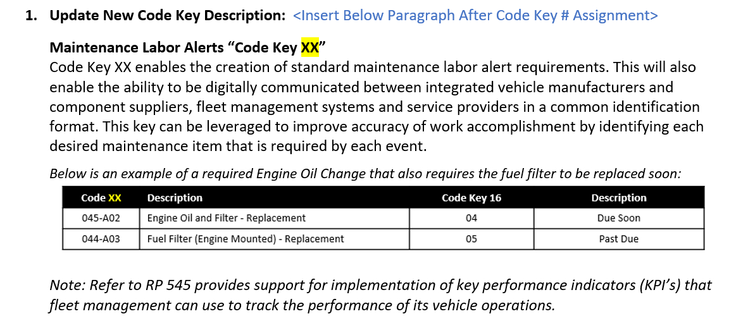
RP 802F:
Section for New Code Key – Maintenance & Inspection Alert:

Slide 23
RP 802F:
VMRS Benefits Update – To include standard Maintenance Labor Alerts:

Slide 24
Questions / Discussion

